Slide 1


IBM Cognos CSR Dashboard
Done by:
Sathish kumar Yadav (221191101130)
MG.Vishaal neel raju (221191101154)
M.Vishal(221191101155)

Slide 2
Corporate Social Responsibility (CSR) Reporting Dashboard
Reports
Declaring the report of the corporate Social Responsibility
Visualization
Visualization of the following reports through different ways and medium.
Performance
Proving the performance of the reports collected.

Slide 3
Abstract:
In the wake of increasing societal and stakeholder demands for corporate accountability and sustainable practices, organizations are turning to Corporate Social Responsibility (CSR) reporting as a means to communicate their environmental, social, and governance (ESG) performance. The CSR Reporting Dashboard emerges as a comprehensive tool designed to facilitate transparent and effective management of sustainability initiatives. This abstract explores the conceptualization, design, and functionalities of such a dashboard.
The CSR Reporting Dashboard aggregates key performance indicators (KPIs) across various sustainability domains, offering stakeholders a holistic view of the organization's CSR efforts. Through intuitive data visualization techniques, including graphs, charts, and trend analysis, the dashboard enables users to track progress, identify areas for improvement, and make informed decisions.

Slide 4
INTRODUCTION
In today's rapidly evolving business landscape, the integration of sustainability into corporate strategy has become increasingly imperative. With heightened awareness of environmental and social issues, coupled with growing stakeholder expectations, organizations are under mounting pressure to demonstrate their commitment to Corporate Social Responsibility (CSR) in tangible and measurable ways.
At its core, the CSR Reporting Dashboard serves as a centralized hub for aggregating and visualizing key sustainability metrics and initiatives. It offers stakeholders, including executives, investors, employees, customers, and the broader community, a transparent and accessible platform to track an organization's progress towards its CSR goals.

Slide 5
Steps to create a dashboard:
Create a data set for the given topic and then upload it in cognos by converting it as data module.
Then create New/Select dashboard/ Select the dashboard layout as per your choice or requirement.
Select the course from my content as the data module you have uploaded.
Select the required the charts and visualization which you need to definr the reports or data.

Slide 6
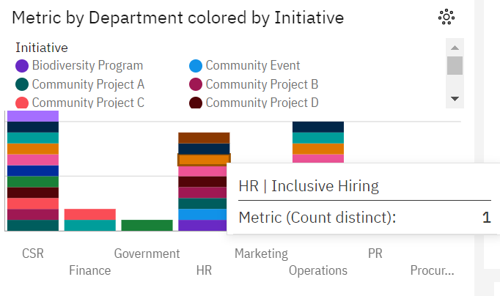
Metric by department by Initiative.
In this graph it’s defined as Bar graph model so that we can compare each data from and other easily and find out the difference from it.

Slide 7
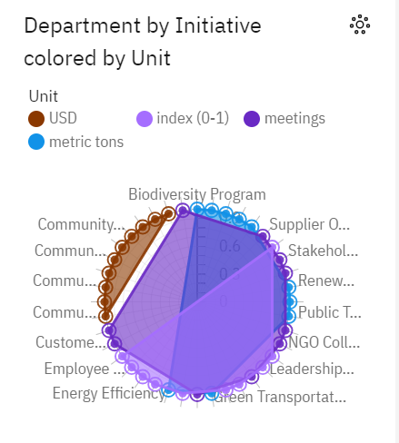
Department by Initiative colored by Unit.
In this Visualization we can easily see that the data has been converted in to spherical manner such that data is been marked from various color’s so it can easily visible the difference.

Slide 8
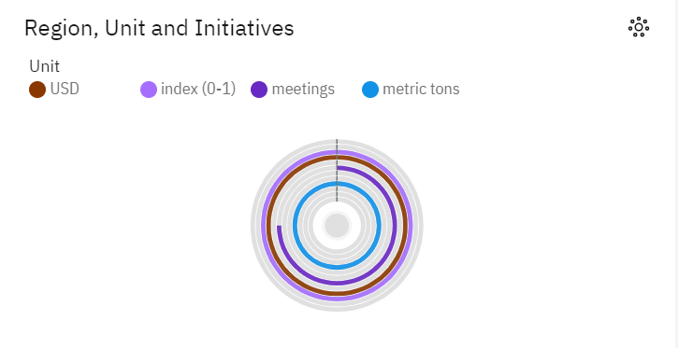
Region, Unit and Initiatives.
It’s to be in the format of many circles chart.
In this chart we can mandatory the formation of each data to its revolution and all data’s have different color for simplification.

Slide 9
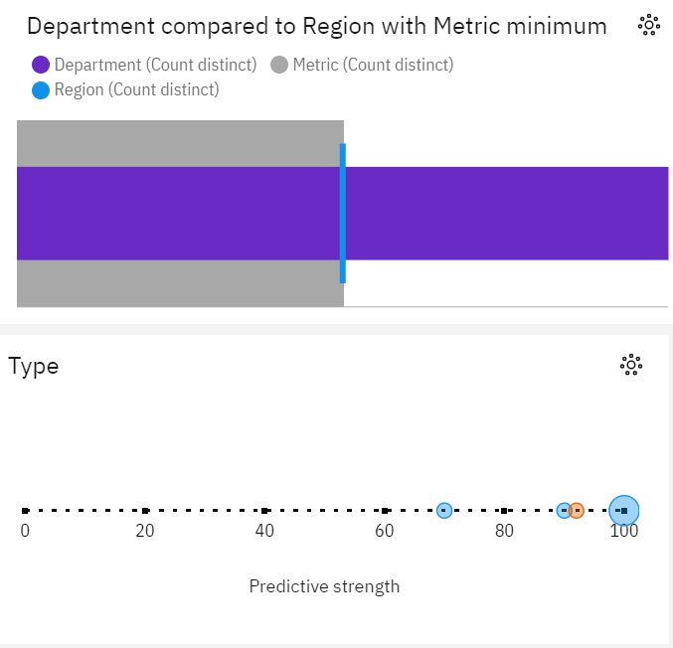
Department Compared

Slide 10
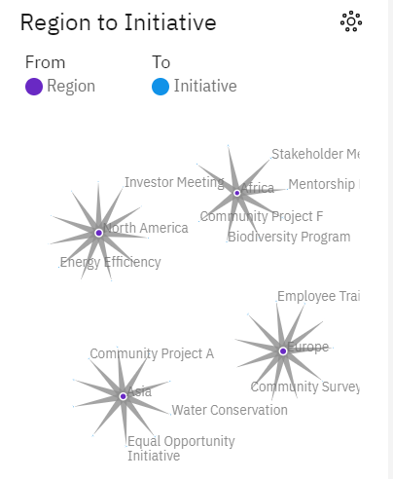
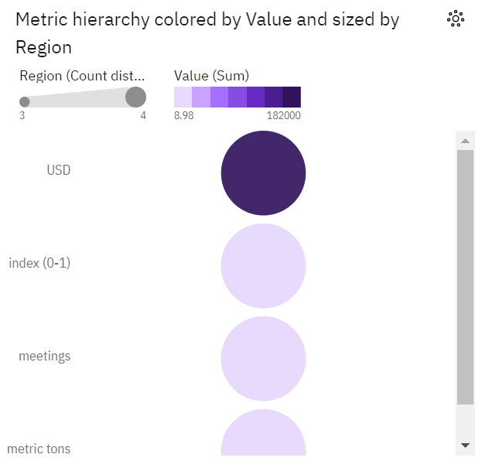
Other’s

Slide 11
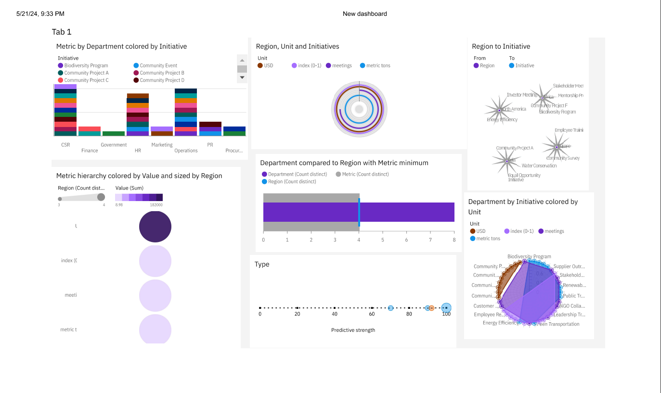
DASHBOARD

Slide 12
Conclusion
In conclusion, Corporate Social Responsibility (CSR) has evolved from a mere buzzword to a fundamental aspect of modern business strategy. It represents a paradigm shift in how organizations perceive their role in society, emphasizing the importance of ethical, sustainable, and responsible conduct.
Through CSR initiatives, companies not only address pressing social and environmental challenges but also create long-term value for stakeholders, including employees, customers, investors, and communities. By integrating CSR principles into their operations, organizations can enhance their reputation, mitigate risks, and foster innovation, ultimately driving business success.
Moreover, CSR is not just a moral imperative but also a strategic imperative. In an increasingly interconnected and transparent world, consumers, investors, and regulators demand greater accountability and transparency from corporations. Embracing CSR allows companies to build trust, credibility, and resilience, positioning them for sustained growth and competitiveness in the global marketplace.
https://us1.ca.analytics.ibm.com/bi/?perspective=dashboard&pathRef=.my_folders%2FNew%2Bdashboard&action=view&mode=dashboard

Slide 13
Thank You

